Slide 1
JAY MENDOZA
For SBFCC Director

Slide 2
SUBIC CHAMBER VOLUNTEER
For Over Five Years

Slide 3
JAY MENDOZA for SBFCC Director
He has been a Subic Bay Freeport Chamber of Commerce (SBFCC) Volunteer for more than five (5) Years.
Representing the SBFCC for:
Labor related matters
Freeport Security Concerns
Environmental Concerns
Government Policies
Labor Skills Mapping
Outreach Programs

Slide 4
JAY MENDOZA for SBFCC Director
PTESDC DISCUSSIONS WITH GOVERNOR AMOR DELOSO

Slide 5
JAY MENDOZA for SBFCC Director
SBFCC Volunteer for the annual DOLE/TESDA/DTI Industry Forum

Slide 6
JAY MENDOZA for SBFCC Director
DOTC-OTS Port Security Forum
and Emergency Response Exercises

Slide 7
JAY MENDOZA for SBFCC Director
He has been actively representing not only the interest of the Chamber but the interests of the business locators in the SBFZ in all Government and Non-government forum on local and national levels.

Slide 8
No Job is TOO BIG and No Task is too small…

Slide 9
JAY MENDOZA for SBFCC Director
LABOR POLICY DIALOGUES WITH THE DOLE AND SBMA

Slide 10
JAY MENDOZA for SBFCC Director
Focus Discussion Group Member of the
DOLE Labor Contractualization Legislative Amendments

Slide 11
JAY MENDOZA for SBFCC Director
Lecturer for the next generation of SBFZ workers
On work ethics

Slide 12
JAY MENDOZA for SBFCC Director
SBFCC Volunteer representative on the Fight Against
Illicit Trade

Slide 13
JAY MENDOZA for SBFCC Director
For over 5 years now, Jay Mendoza has been using his spare time as a volunteer for the SBFCC as its representative for discussion groups and forum or as the actual ground personnel for projects and activities.

Slide 14
JAY MENDOZA for SBFCC Director
Volunteer Relief Responder for the Flooding Victims of Sta. Cruz Zambales
(Typhoon LANDO – October 2015)

Slide 15
JAY MENDOZA for SBFCC Director
Volunteer SBFCC Emergency Relief Response Team
during the Yolanda (Typhoon Haiayan) Aftermath

Slide 16
JAY MENDOZA for SBFCC Director
Volunteer Project Coordinator for the Yolanda Victims of Tanauan Leyte

Slide 17
JAY MENDOZA for SBFCC Director
Volunteer SBFCC Project Coordinator for the Yolanda Victims of Tanauan Leyte

Slide 18
JAY MENDOZA for SBFCC Director
SBFCC Volunteer for the Yolanda Victims of Tanauan Leyte

Slide 19
JAY MENDOZA for SBFCC Director
Volunteer for the SBFCC Potable Water System Project in Leyte

Slide 20
JAY MENDOZA for SBFCC Director
Volunteer for the SBFCC -Elementary School Rehab Project in Tanauan Leyte

Slide 21
JAY MENDOZA for SBFCC Director
Volunteer for the SBFCC –Multi-Purpose Hall Project in Tanauan Leyte

Slide 22
JAY MENDOZA for SBFCC Director
Volunteer for the SBFCC –Multi-Purpose Hall Project in Tanauan Leyte

Slide 23
JAY MENDOZA – Quick Bio
Chief of Staff for the Global Group of Companies
Born in Olongapo City, Philippines
Bachelor’s of Law – Arellano University/ RMTU
Bachelor’s Degree in Psychology from the University of the Philippines
Former Supreme Court Philja-PMC Mediator

Slide 24
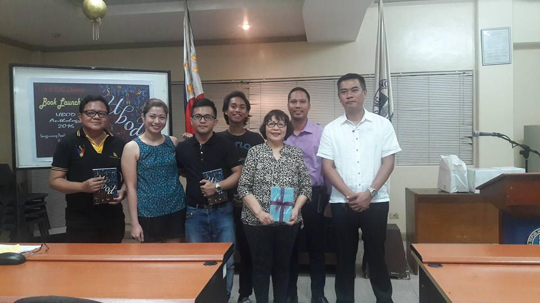
JAY MENDOZA – Quick Bio
Special Interests:
Literature
Contributing Author for the National Commission for Culture and the Arts
(NCCA) Literary Anthology Book 2016

Slide 25
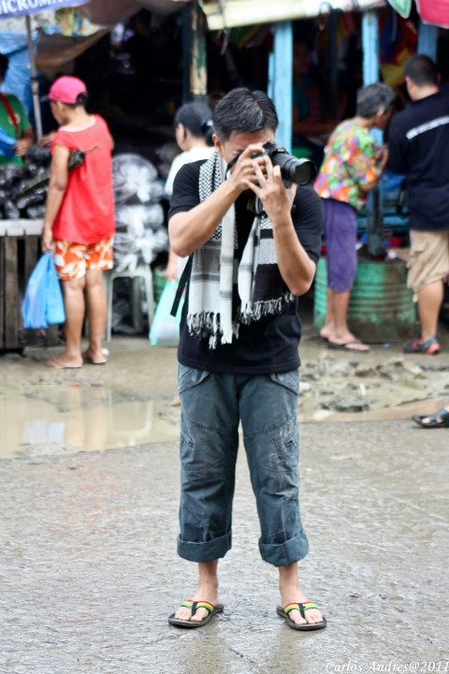
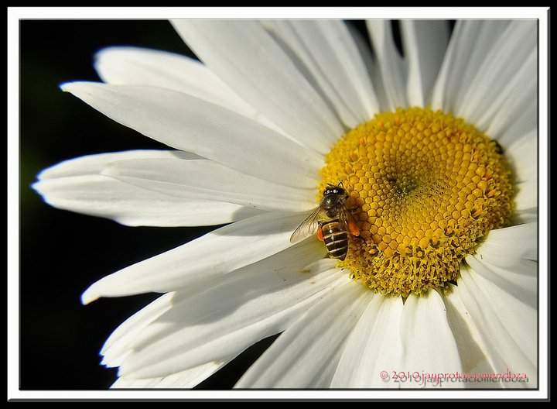
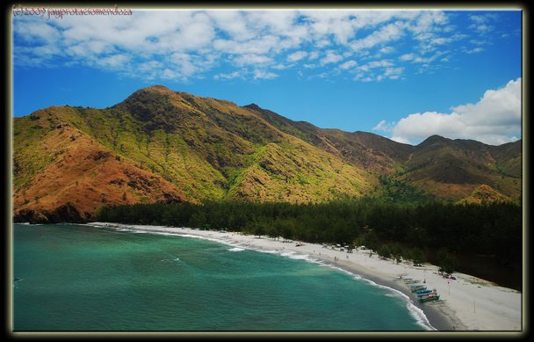
JAY MENDOZA – Quick Bio
Special Interests:
Photography

Slide 26
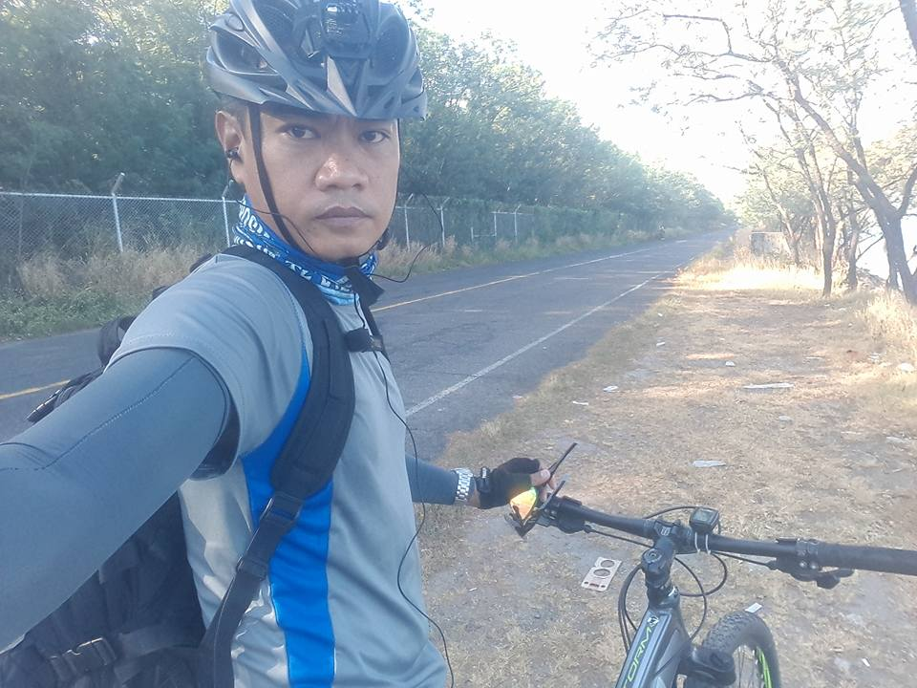
JAY MENDOZA – Quick Bio
Special Interests:
Biking

Slide 27
KNOWLEDGE
EXPERIENCE
HARD WORK
& the heart - to help others
SUBIC BAY FREEPORT CHAMBER OF COMMERCE

Slide 28
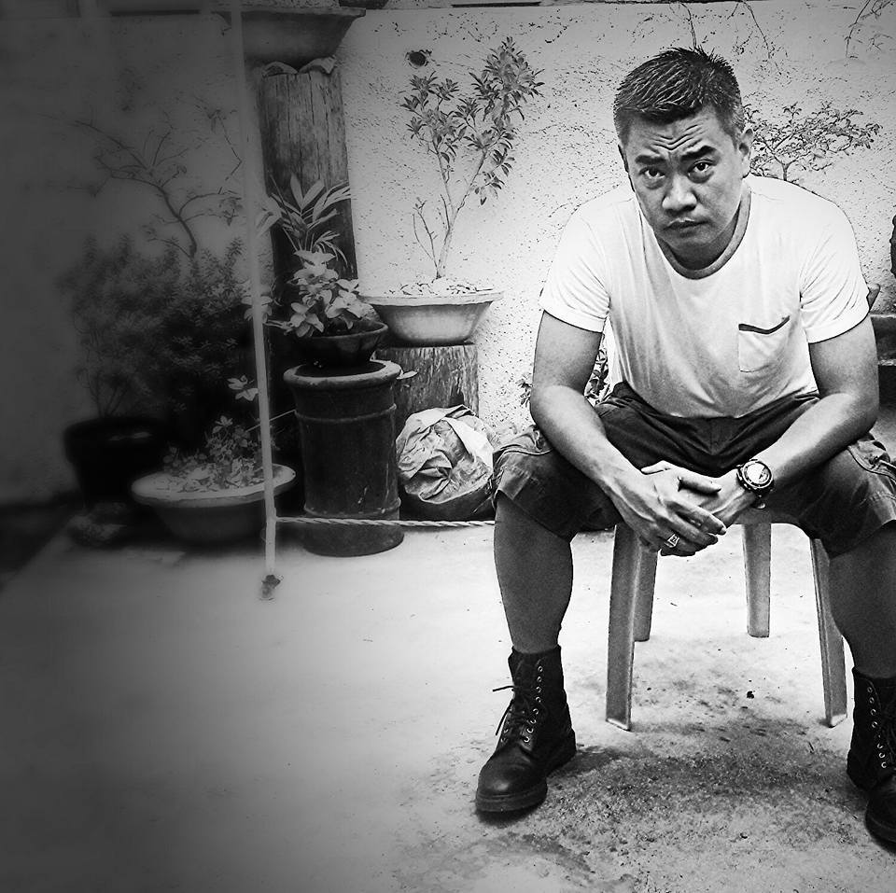
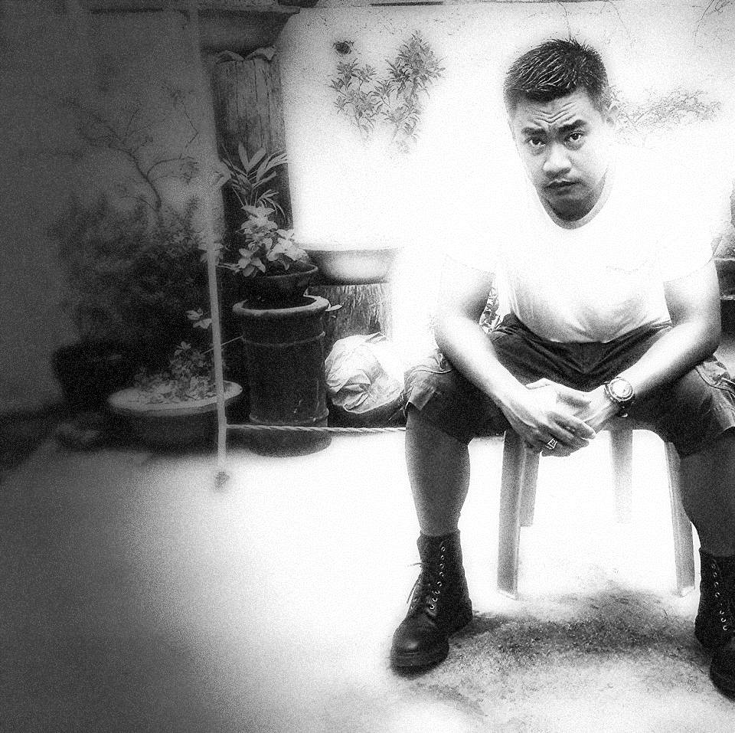
JAY MENDOZA
your Hard working
chamber volunteer

Slide 29
PLEASE VOTE
FOR BOARD DIRECTOR
SUBIC BAY FREEPORT CHAMBER OF COMMERCE

